Slide 1
Usability Testing for
Code Critiquer
Andrea Lee

Slide 2
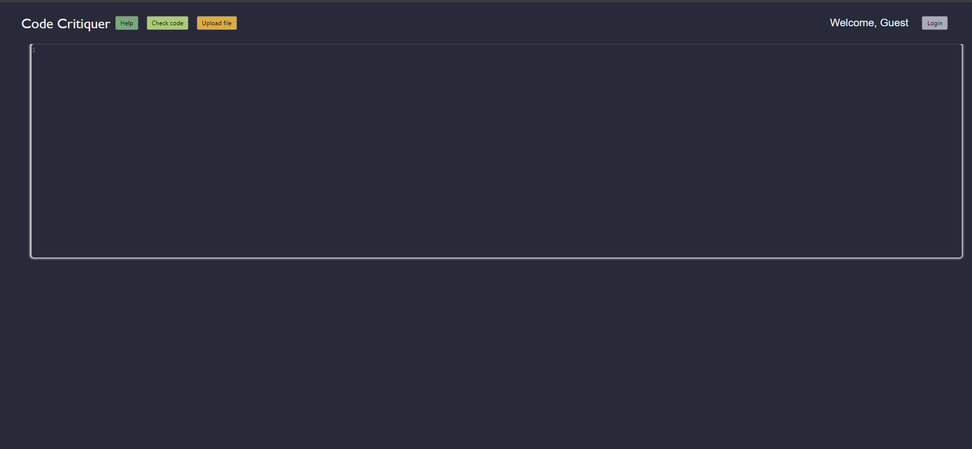
Purpose
The code critiquer
Antipatterns
Primary Intended users:
Students
Independent learners
Figure 1: User interface of Code Critiquer

Slide 3
Procedure
Two Scenarios – one for each method of input
Scenario one – text entry
Participants were prompted to write their own program to increase possible antipatterns
Scenario two – file upload

Slide 4
Results
Majority of users quickly understood front end interface design
File upload has white text on a white background
All code receive a notification requiring a “comment header block”
No participants could determine the exact format required
Figure 2: Common issues with using the code critiquer.

Slide 5
Answers to Questionnaire
Pretest
Average experience with java: ~1.7 years
Half of the participants did programming outside of school
Posttest
6/8 participant stated that the critiquer was easy to use
6/8 would use the critiquer on future homework assignments
4/8 would use the critiquer outside of school

Slide 6
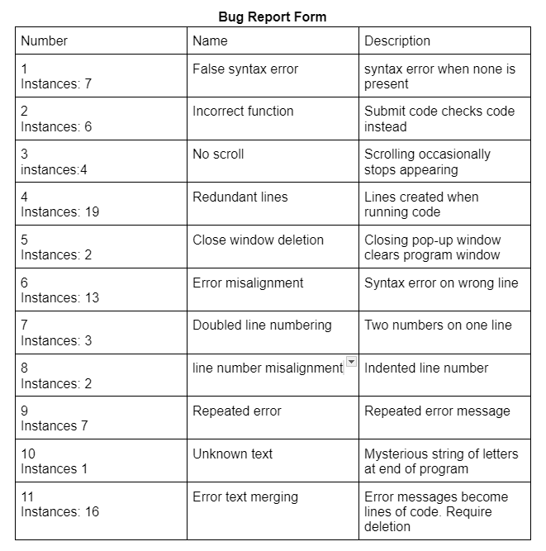
Bugs Discovered
Important Bugs:
Submit file button does not upload file
Error messages become plain text if check code function is ran a second time
Running the check code function creates additional, unnecessary lines
Figure 3: Bugs discovered within Code Critiquer

Slide 7
Recommendations
Additional descriptions for antipatterns
Explain why the anti pattern could lead to an error
Provide examples of best practices
Make critique downloads available to guests as well as logged in users.

Slide 8
Next Presenter

